Slide 1

Leaflets
Lets explore features of leaflets…

Slide 2

Eye-catching background
Talking Partners: What features can you spot?

Slide 3

Logo
Talking Partners: What colours are used?

Slide 4

Examples of activities
Talking Partners: Can you read the list?

Slide 5

Contact Information
Talking Partners: What information is given?

Slide 6

Large pictures
Talking Partners: Why is there 4 big pictures?

Slide 7

Large, bold heading
Talking Partners: What stands out most?

Slide 8
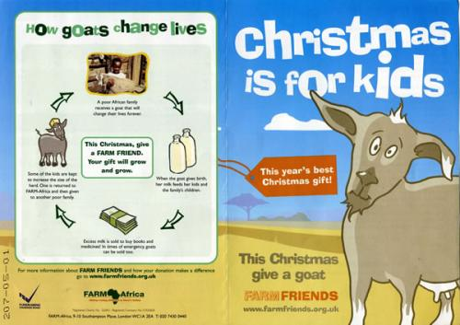
Sub-heading
Talking Partners: What is a sub-heading?

Slide 9

Quote
Talking Partners: Why include a quote?

Slide 10

Which features will you include on your leaflet? Why?

Slide 11
