Slide 1
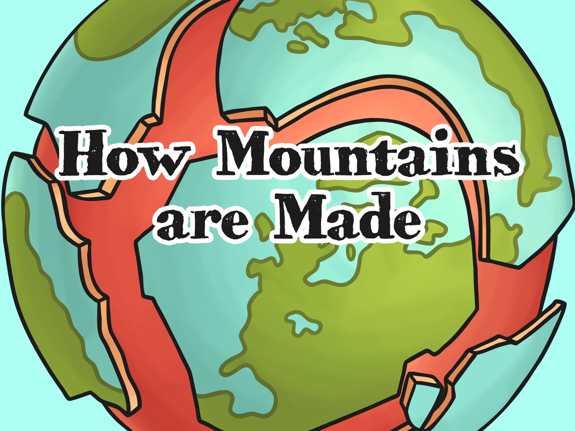


Slide 2
Aim
I can explain how different types of mountains are formed.
Success Criteria
I can tell you that mountains formed a very long time ago.
I can describe how tectonic plates move together to create fold mountains.
I can describe how lava flow creates volcanic mountains.
I can describe how fault lines in the Earth’s crust move to create mountains.
I can describe how pressure from magma under the Earth’s surface creates
dome mountains.
I can describe how erosion creates plateau mountains.

Slide 3

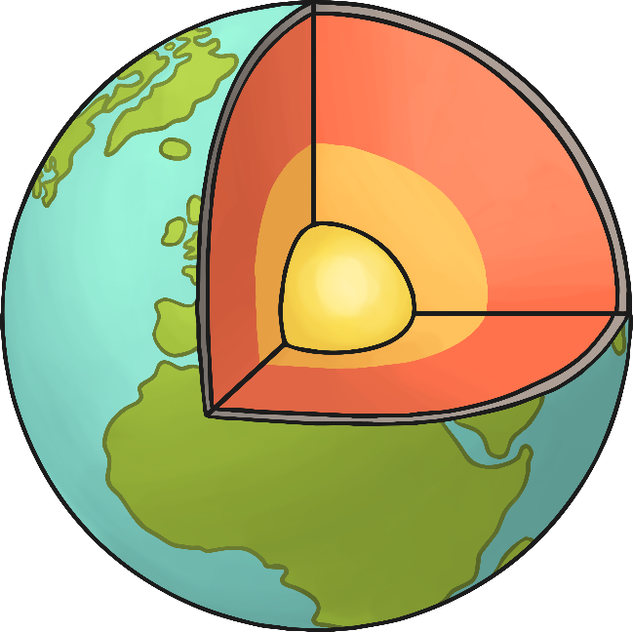
Can You Remember What’s
under Your Feet?
Can you join the words to the correct layers?
inner core
mantle
crust
outer core

Slide 4
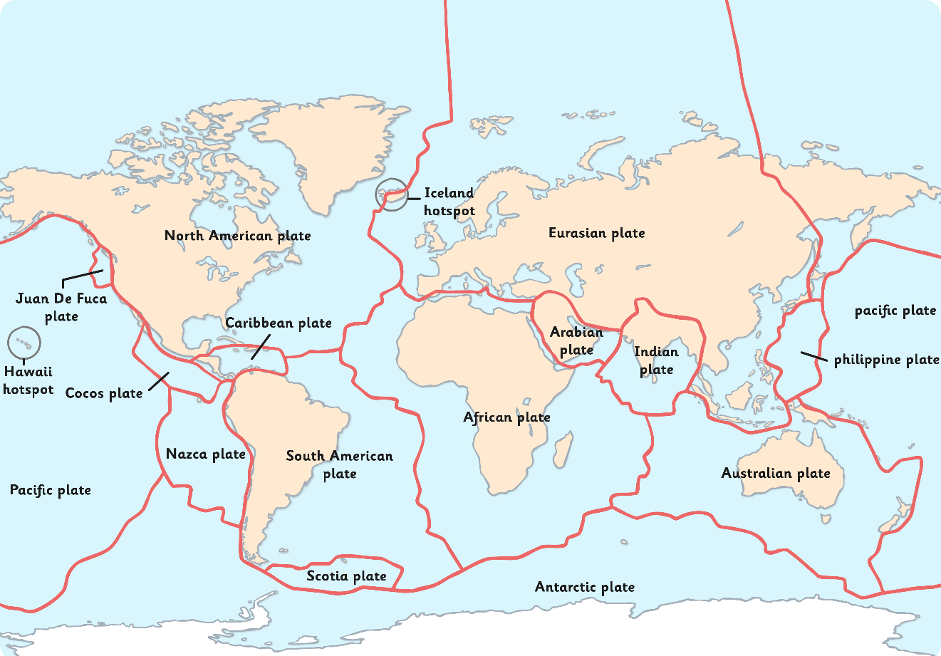
Can You Remember What’s
under Your Feet?
The Earth’s crust isn’t one solid layer.
It is broken up into huge areas called tectonic plates that float on top of the mantle.
This map shows where the tectonic plates are.

Slide 5

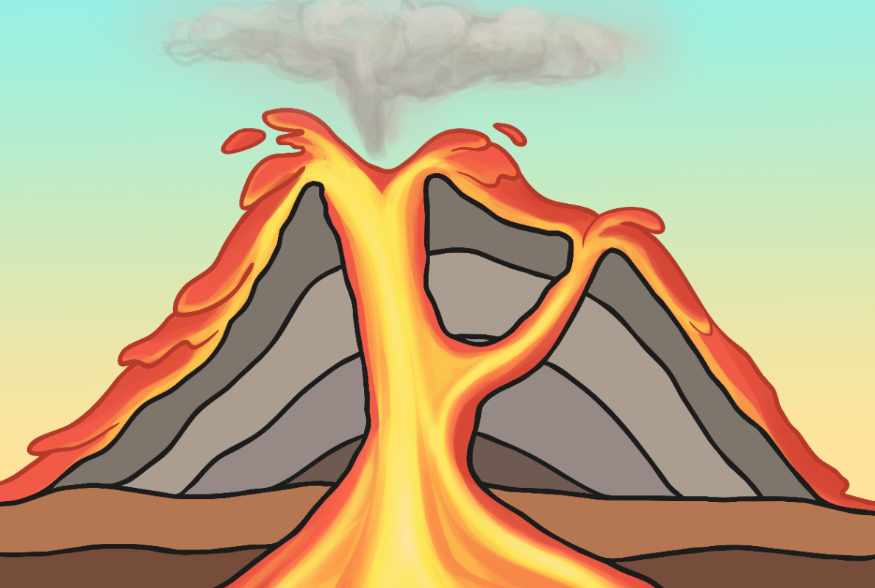

What Have Tectonic Plates
Got to Do with Mountains?
What happens when magma escapes through gaps in the Earth’s surface?
Volcanoes are one way mountains
were formed.
Watch the video to find out another way.

Slide 6
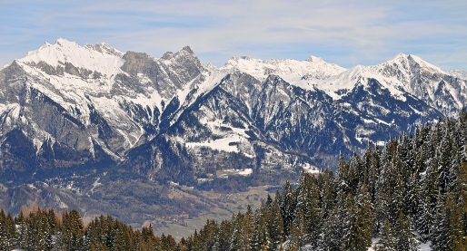
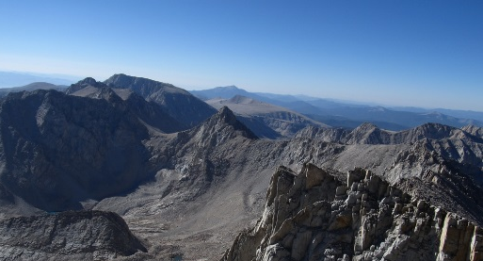
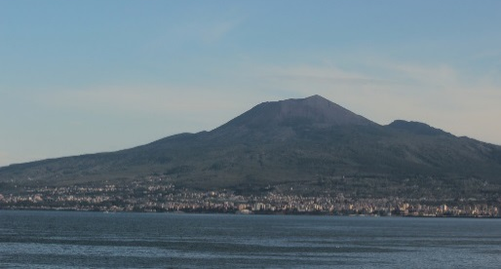
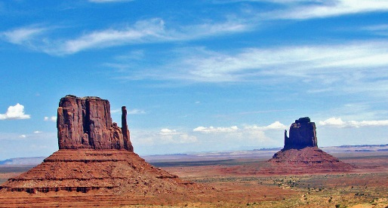
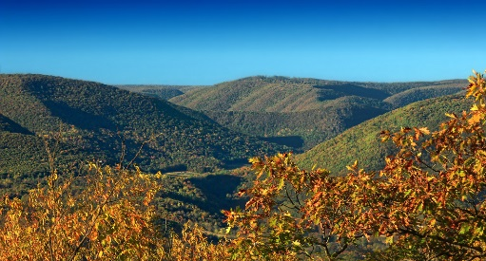
How Mountains are Made
There are 5 main types of mountains:
fold mountains
fault-block mountains
volcanic mountains
dome mountains
plateau mountains
Each one is formed differently.
Photo courtesy of Tambako the Jaguar, Ken Lund, DragonGhost19, inkknife_2000 and Nicholas_T @flickr.com) - granted under creative commons licence – attribution

Slide 7
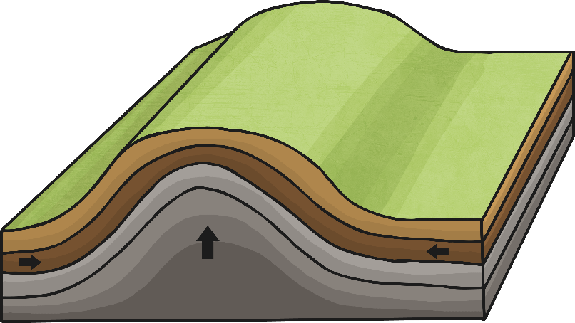

Fold Mountains
Fold mountains occur when tectonic plates collide.
The edges of the plates crumple as they are pushed together.
The rock of the Earth’s surface is pushed up to create mountains.
The Alps are fold mountains.
Photo courtesy of Tambako the (@flickr.com) - granted under creative commons licence – attribution

Slide 8
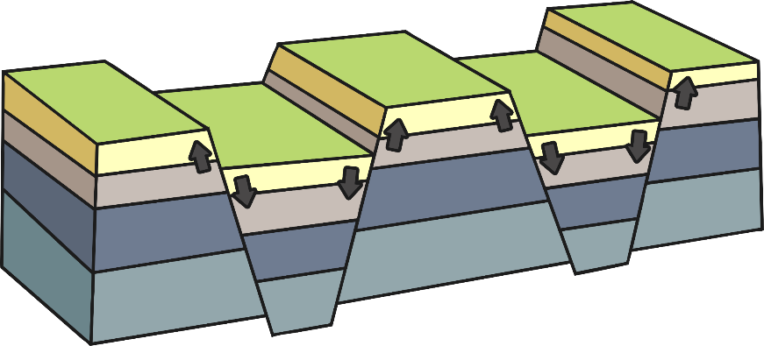

Fault-block Mountains
When cracks in the Earth’s surface open up, large chucks of rock can be pushed up while others are pushed down.
This creates mountains with a long slope on one side, and a sharp drop on the other.
The Sierra Nevada mountains
in California, USA are
fault-block mountains.
Photo courtesy Ken Lund (@flickr.com) - granted under creative commons licence – attribution

Slide 9
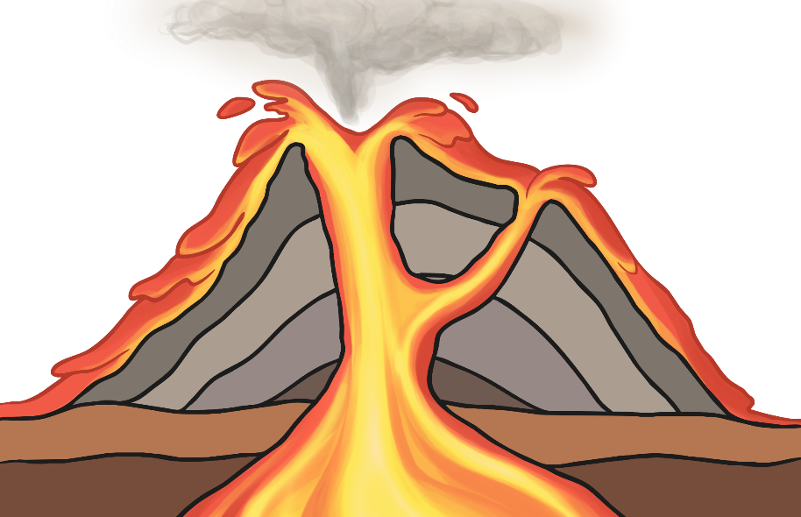
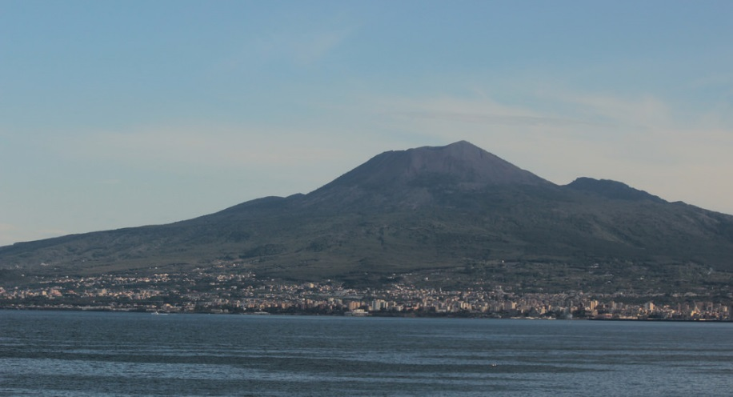
Volcanic Mountains
Volcanic mountains are formed around volcanoes.
Volcanic mountains are made of layers of ash and cooled lava.
Mount Vesuvius, Italy is a volcanic mountain.
Photo courtesy of DragonGhost19 (@flickr.com) - granted under creative commons licence – attribution

Slide 10
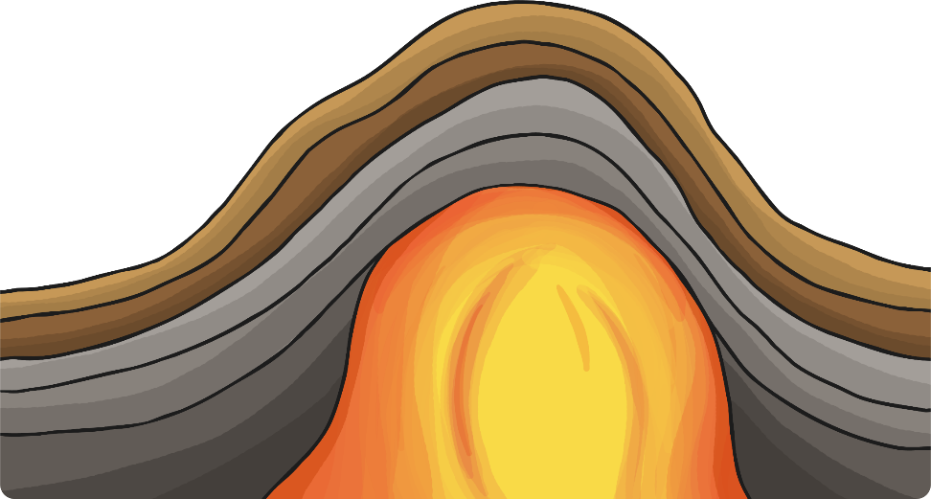
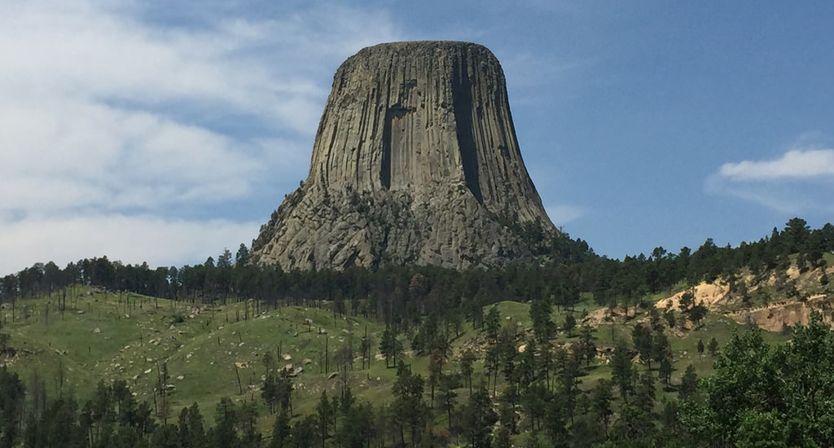
Dome Mountains
Dome mountains are smooth and round-looking.
They are formed when magma is forced up between the crust and the mantle, but doesn’t ever flow out.
The magma makes the land bubble up like a balloon.
Devils Tower, USA
is a dome mountain.
Photo courtesy of inkknife_2000 @flickr.com) - granted under creative commons licence – attribution

Slide 11
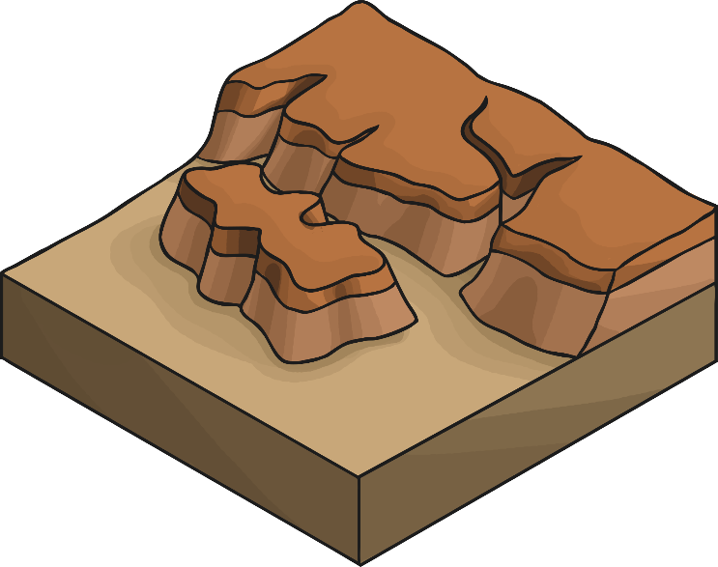

Plateau Mountains
Plateau mountains are different from the other mountain types.
They haven’t formed because of rock or magma being pushed up.
They form because of materials being taken away through erosion, which has left deep valleys or gorges next to high cliffs.
The Allegheny Mountains,
USA, are an example of this
type of mountain.
Photo courtesy of Nicholas_T (@flickr.com) - granted under creative commons licence – attribution

Slide 12
Task
Use an atlas, map or globe to find the mountains mentioned in the previous few slides.
If you don’t have an atlas, map or globe at home, you can use the internet.

Slide 13
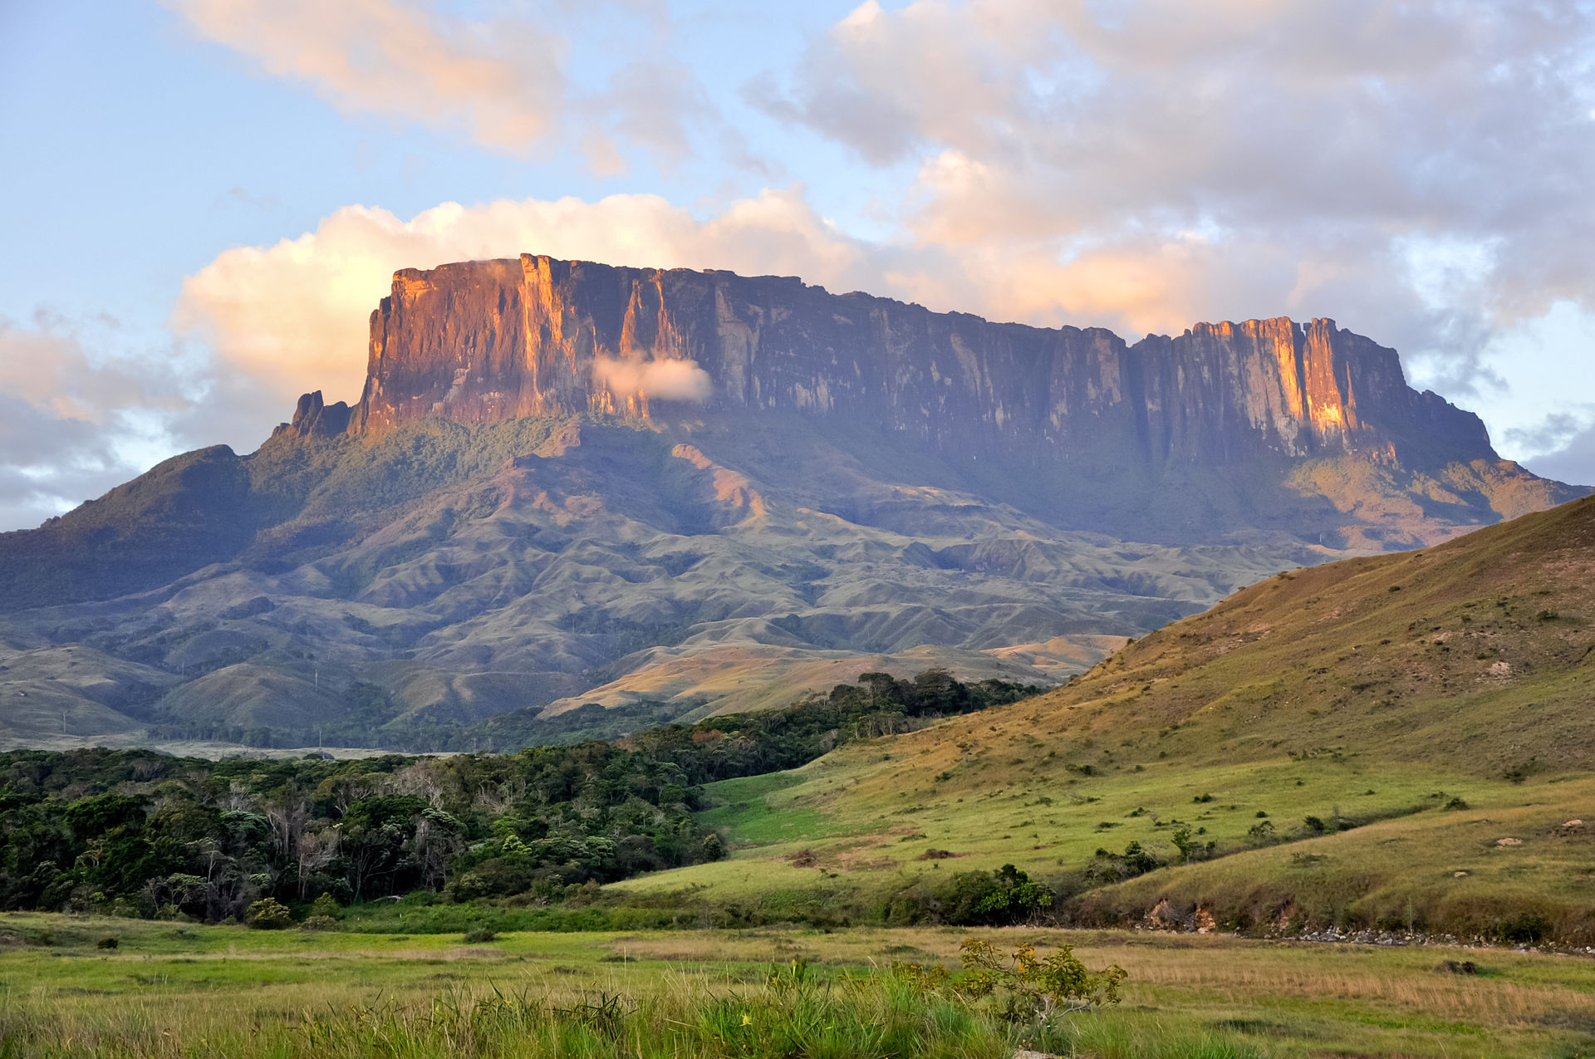
How Were These Mountains Made?
These are dome mountains. They were formed when magma was forced up between the crust and the mantle, but the magma didn’t flow out.
"Kukenan Tepuy at Sunset" by Paolo Costa Baldi - Own work. Licensed under CC BY-SA 3.0 via Wikimedia Commons

Slide 14
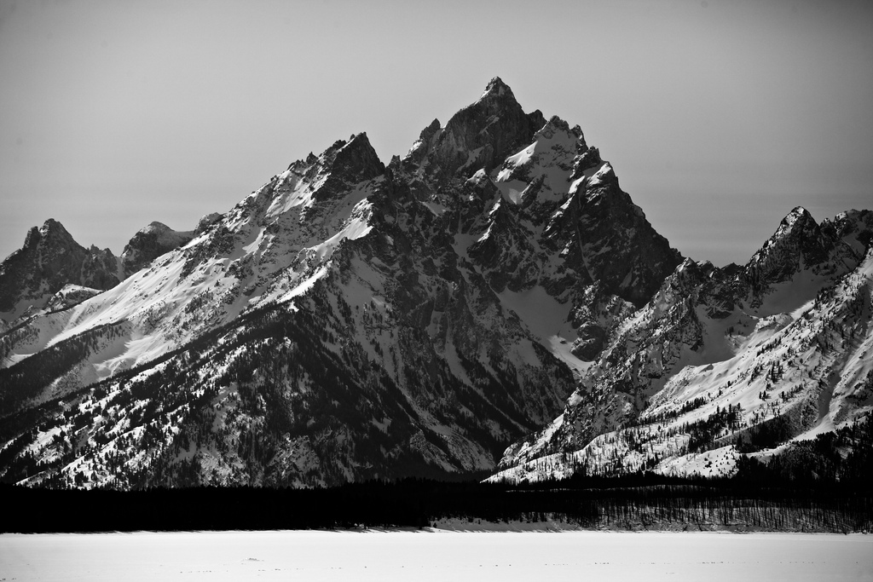
How Were These Mountains Made?
These are fold mountains. They formed when the rock of the Earth’s surface was pushed up by tectonic plates colliding.
Photo courtesy of Zach Dischner @flickr.com) - granted under creative commons licence – attribution

Slide 15
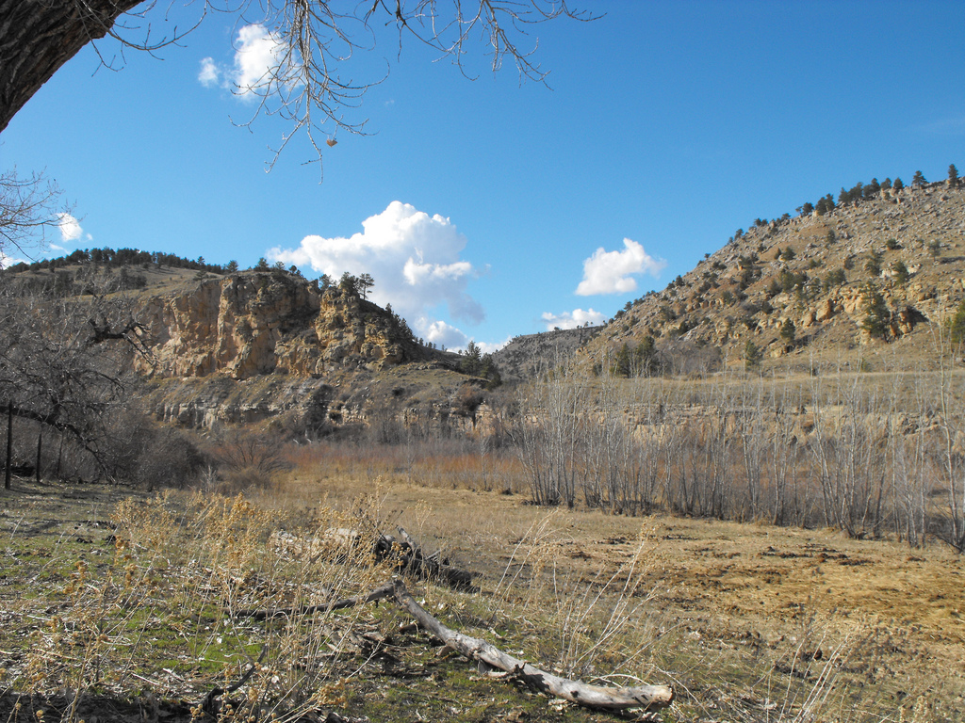
How Were These Mountains Made?
This is a plateau mountain. It was formed when materials were taken away through erosion, which has left deep valleys or gorges next to high cliffs.
Photo courtesy of Eric Lumsden @flickr.com) - granted under creative commons licence – attribution

Slide 16
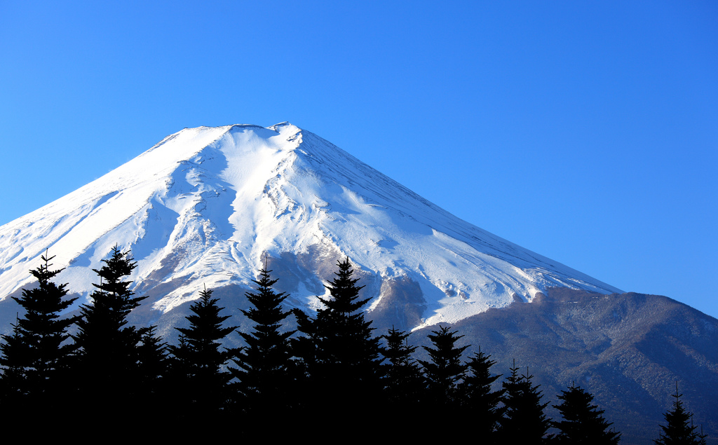
How Were These Mountains Made?
This is a volcanic mountain. It is made out of layers of ash and cooled lava.
Photo courtesy of TANAKA Juuyoh (田中十洋) (@flickr.com) - granted under creative commons licence – attribution

Slide 17
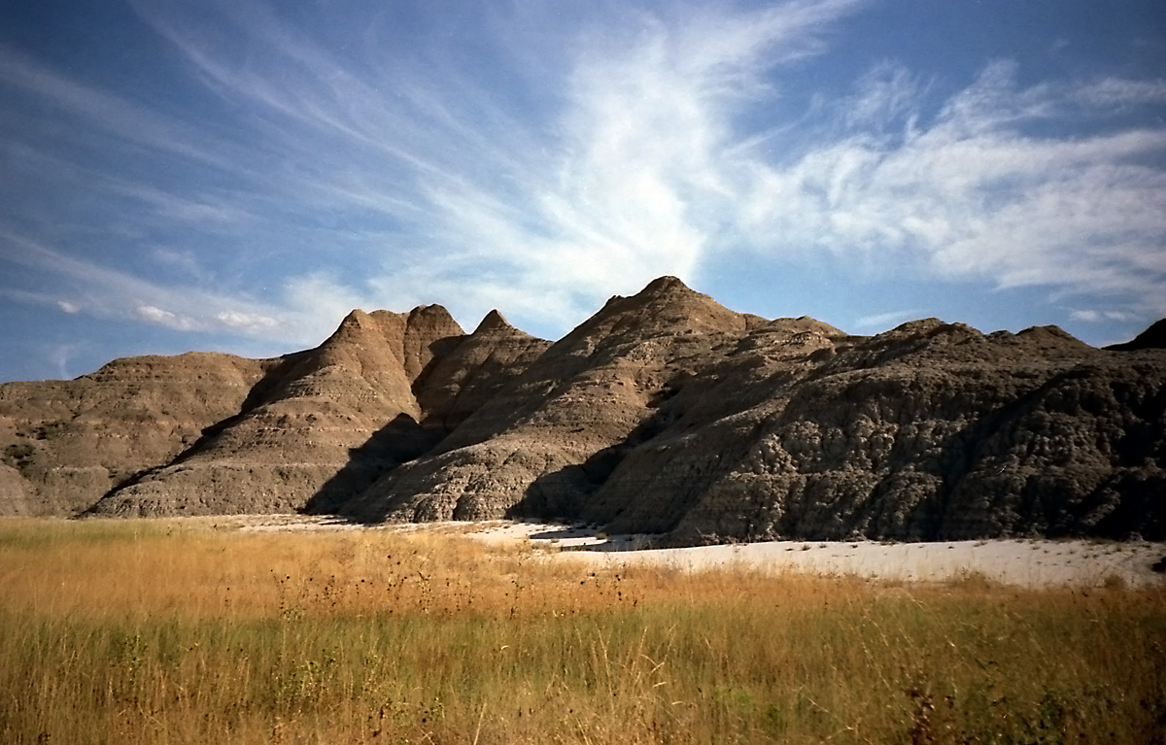
How Were These Mountains Made?
This is a fault-block mountain. It formed when cracks in the Earth’s surface open up and large chucks of rock were pushed up while others
were pushed down.
"Badlands National Park Scan 0015" by Stefan Fussan. Licensed under CC BY-SA 3.0 via Wikimedia Commons

Slide 18
Challenge
Create fact cards for each type of mountain. There is a template in the folder that you can use.
Don’t forget to include: the type of mountain, how it is made and a small diagram/picture.

Slide 19

Aim
I can explain how different types of mountains are formed.
Success Criteria
I can tell you that mountains formed a very long time ago.
I can describe how tectonic plates move together to create fold mountains.
I can describe how lava flow creates volcanic mountains.
I can describe how fault lines in the Earth’s crust move to create mountains.
I can describe how pressure from magma under the Earth’s surface creates
dome mountains.
I can describe how erosion creates plateau mountains.

