Slide 1

Primary Forest School
Online Learning – KS1 Geography Activities

Slide 2

The important bit for parents and teachers… but you can have a sneak peek at the activities too!
Activity | Resources Required | Potential Risks | Impact
Oceans – make a hole & let the rain fill it to make an ocean. Name your ocean. Name the other 5 oceans of the world | Mud | Germs in mud | Children explore naming something knew and learn the names of the 5 oceans of the world
Mapwork - Use a map to find local footpaths and go on a new walk | Local map or online maps | Getting lost! | Children are part of the decision making, using local routes to improve their understanding of maps
Direction - Use a compass to find north | Compass (can be a phone app if required) |  | Children learn the 4 main compass points
Weather - Measure rainfall in a week | Measure jug or similar Graduated scale (if not on the jug) | The floor might get wet! | Children start to appreciate the amount of rain that can fall in a week

Slide 3
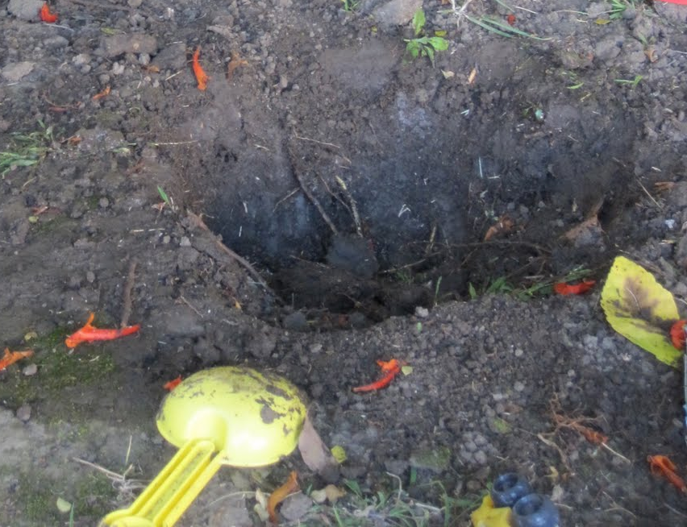
It’s just a drop in the ocean
Oceans are enormous areas of water. There are 5 oceans on our planet: Pacific, Atlantic, Indian, Southern and Arctic Oceans
Dig a hole in some mud
Let the hole fill with water to make your own mini ocean
Give your ocean a name. Maybe you’ll name it after the place you live in, or maybe after you!
How long will your ocean stay for?
Can you learn and remember the names of the 5 oceans of the world?

Slide 4
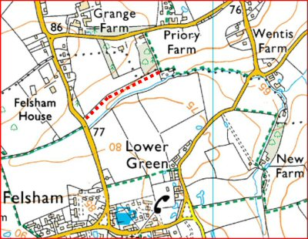
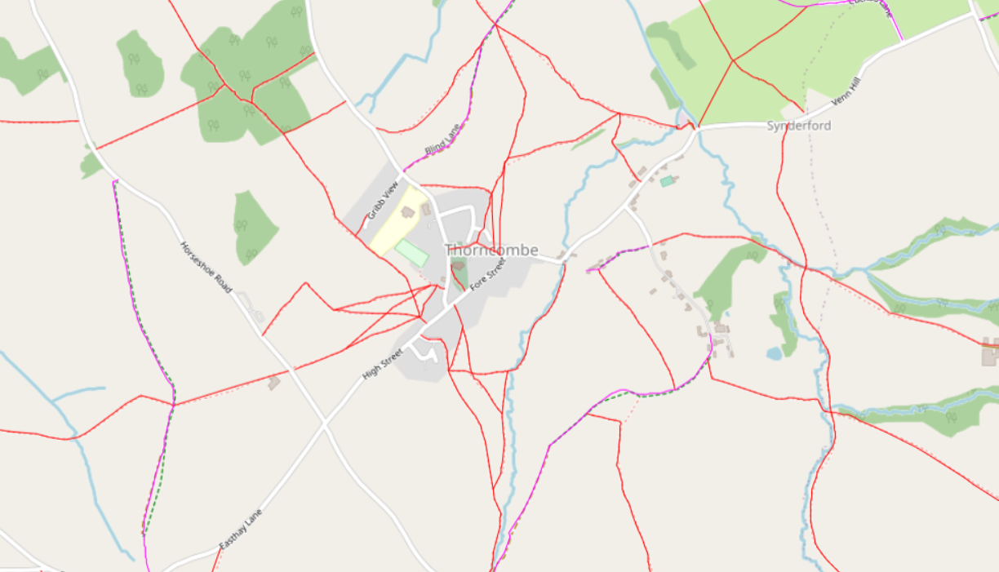
It’s just a hop, skip and jump away
There are thousands of miles of footpaths all over the UK and they have all been mapped.
Using a local map or online mapping (such as footpathmap.co.uk), can you find some local footpaths to you?
On an OS Map, they are green dashes.
Can you make a route, using footpaths, that you could follow for your next family walk?

Slide 5
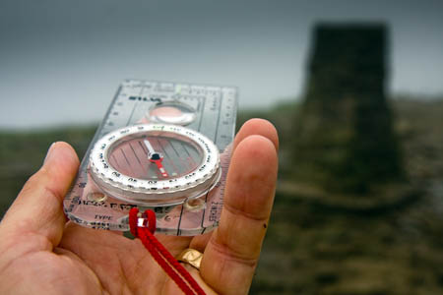
Which way are you bearing?
Compasses have been used for hundreds of years to show people which direction to go in, both on land and on sea.
Turning only your body, rotate until the moving red pin is pointing towards the ‘N’.
You are now facing North!
If you have a compass, turn the bevel until ‘N’ is pointing away from you. There may be an arrow drawn on the plastic showing which way to hold the compass with the arrow facing away from you.
If you are using an app, hold your phone horizontally against your tummy. Turn your body (not the phone) until the arrow points to ‘N’.
You are now facing North!
Do you know the names of the other 3 main directions on a compass?
Can you turn to face these 3 directions too?

Slide 6
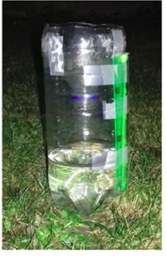
Let it come in floods!
The UK has a lot of rainfall! If you collect the rain for a week in one spot, you will be able to workout how much rain fell.
Place a container out for a week and leave it to collect the rainfall
After a week, pour the collected rain into a measuring jug to see how many mm (millimeters) of rain have fallen.
You could make a device like this with a measuring ruler on the outside so that you can measure the rain without pouring it out!
You could try to find the official rainfall for your area and see how your measurements compare

Slide 7
How did you get on?
What was your favourite activity from this pack?
Share your feedback by:
Emailing - ellen.blackwood@primary-forest-school.co.uk
Find us Facebook or Instagram @PrimaryForestSchools

