Slide 1
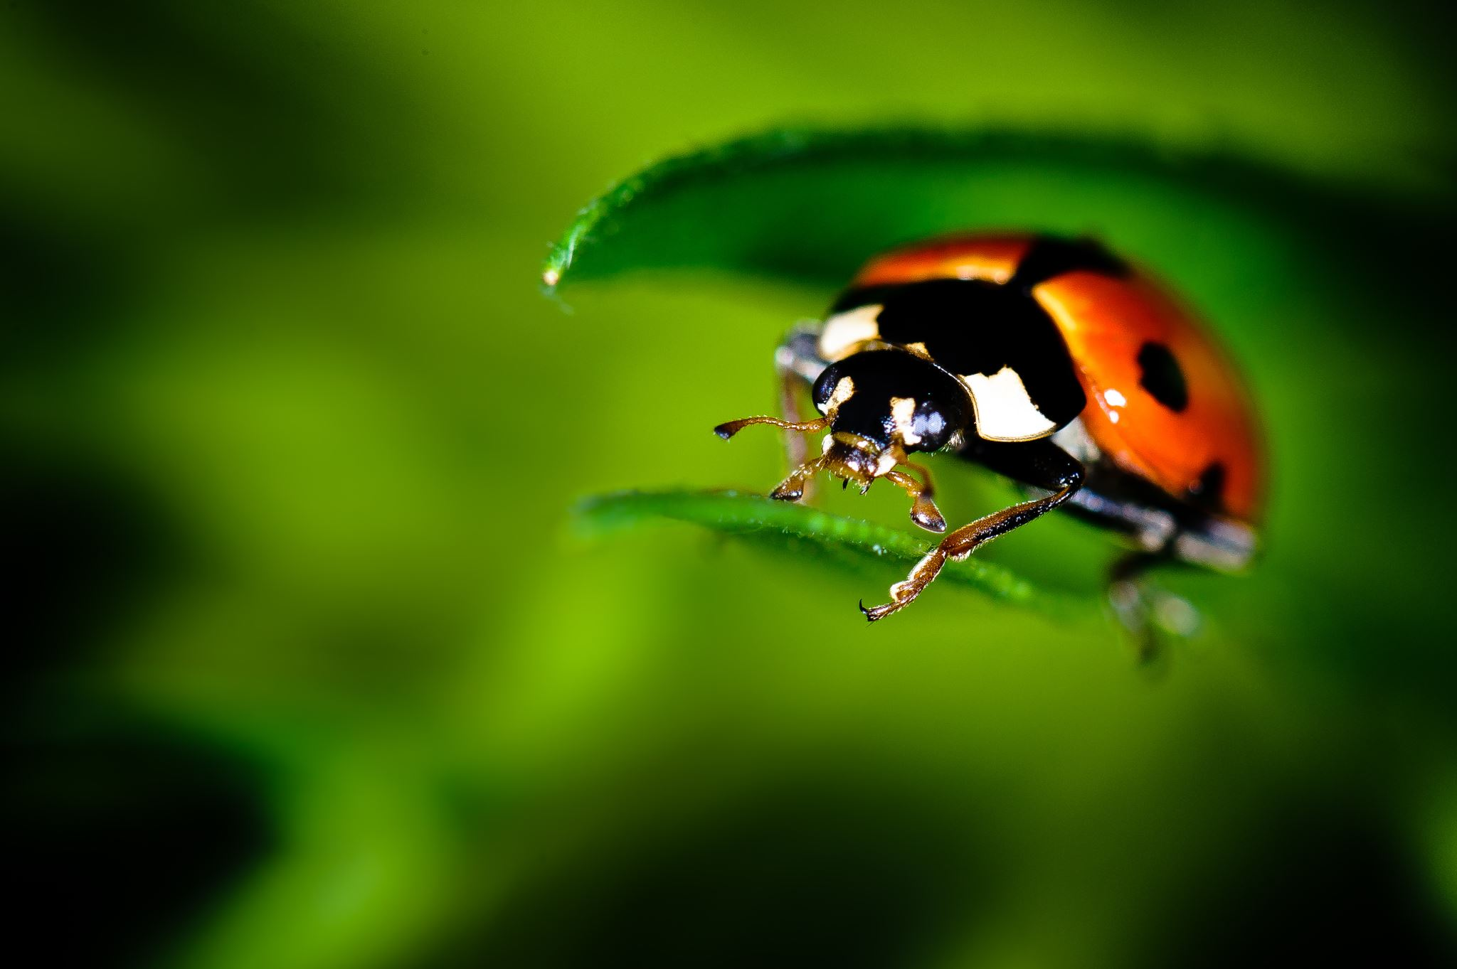

Primary Forest School
Online Learning – minibeasts KS1

Slide 2

The important bit for parents and teachers… but you can have a sneak peek at the activities too!
Activity | Resources Required | Potential Risks | Impact
Skill – Minibeasts Hunting | Bug pot (cleaned yoghurt pot), magnifying glass, outdoor area ideally with logs or stones on ground | Contact with harmful plants/ minibeasts, Lifting items, uneven grounds | Children to use investigative and exploratory skills to find and name minibeasts
Main – Minibeasts Mansion | Recycling items e.g. tin can or flowerpot, grass, dead wood, bamboo sticks, straw, leaves, mud and stones (anything you can find!) | Use of sharp-edged items, Contact with harmful plants/ minibeasts, plastic leaving mansion site | Children to show empathy to the wildlife around them
Extended – Minibeast Masterpieces | Paper/ cardboard, paints, pens/ googly eyes, scissors, lollipop stick or pipe cleanner, pva glue. | Use of paint, use of scissors, getting messy! | Children to incorporate crafts and art into minibeast learning
Mindfulness – Miniature World | An outdoor area safe to lie on, magnifying glass (not essential) | Lying on sharp objects/items, contact with harmful plants | Children to explore the miniature world beneath them

Slide 3
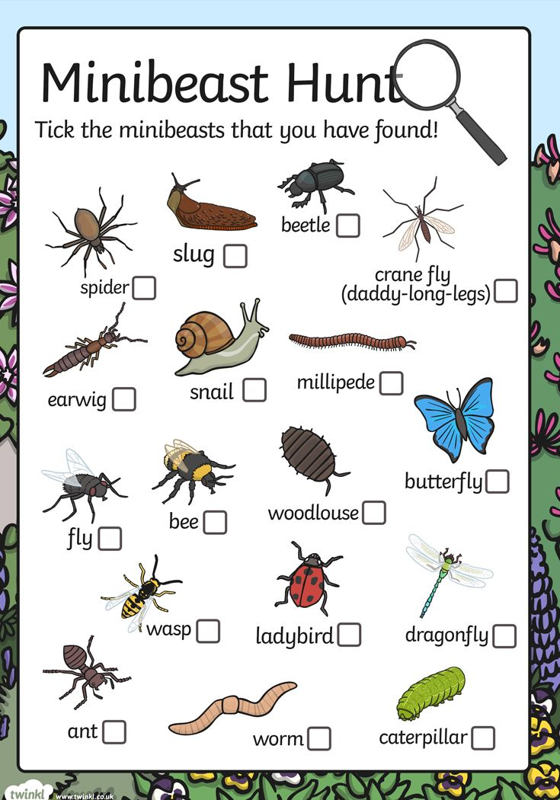
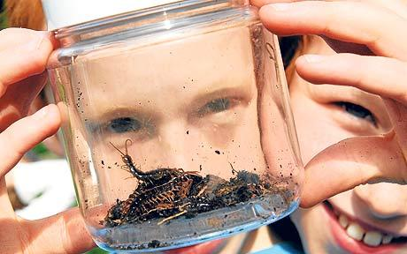
What will you find?
TOP TIP! Have a look under tree stumps and rocks… but remember to put them back too!
Minibeast Hunting
Exploring the outdoor space near you can you go on a minibeast hunt?
You will need to take a pot to collect your bugs in ... Even a clean yoghurt pot or glass jar will do!
Can you describe how your minibeasts look?
For an extra challenge can you name all the minibeasts you find ? Use the ID sheet to help you!
Slimy
Long
Smooth
Wiggly
Round

Slide 4
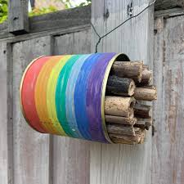
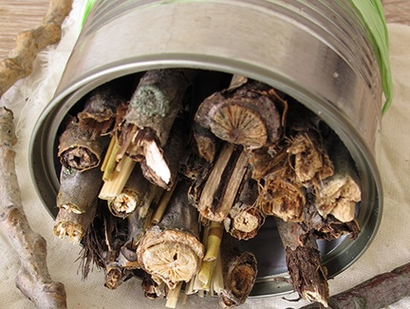
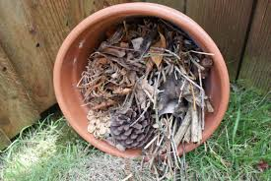
Minibeasts Mansion…
It’s tough living in the wild, why not make your minibeasts a home … or upscale to a mansion!
Where did you find your minibeasts as this will help you to know what to use for your mansion!
Fill tin cans from recycling or unused plant pots with sticks, leaves and other kinds of nature and place in your garden to see who visits!
PARENTS TOP TIP! If using cans, tape any sharp edges.
For an extra challenge could you decorate your minibeast mansion too?

Slide 5
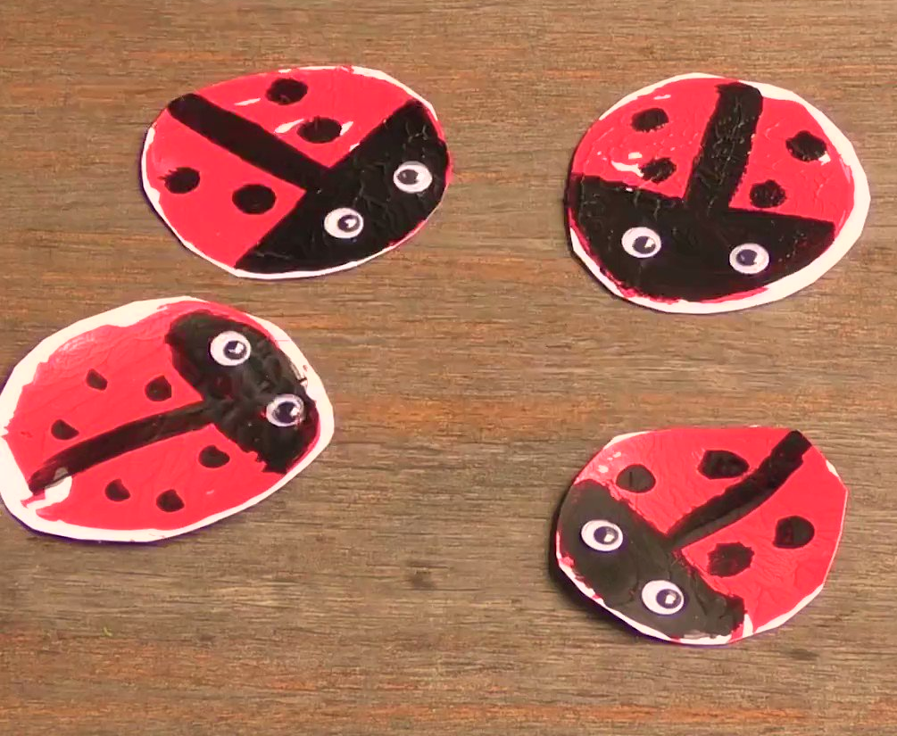
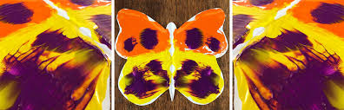
Minibeast Masterpieces!
Time to get creative and make your own minibeasts!
Click on the photos to follow the video on how to make a butterfly or ladybird!
Ladybird Potato Stamps
Symmetry Butterfly
For an extra challenge can you make any other minibeasts using your hands or vegetables as stamps?

Slide 6
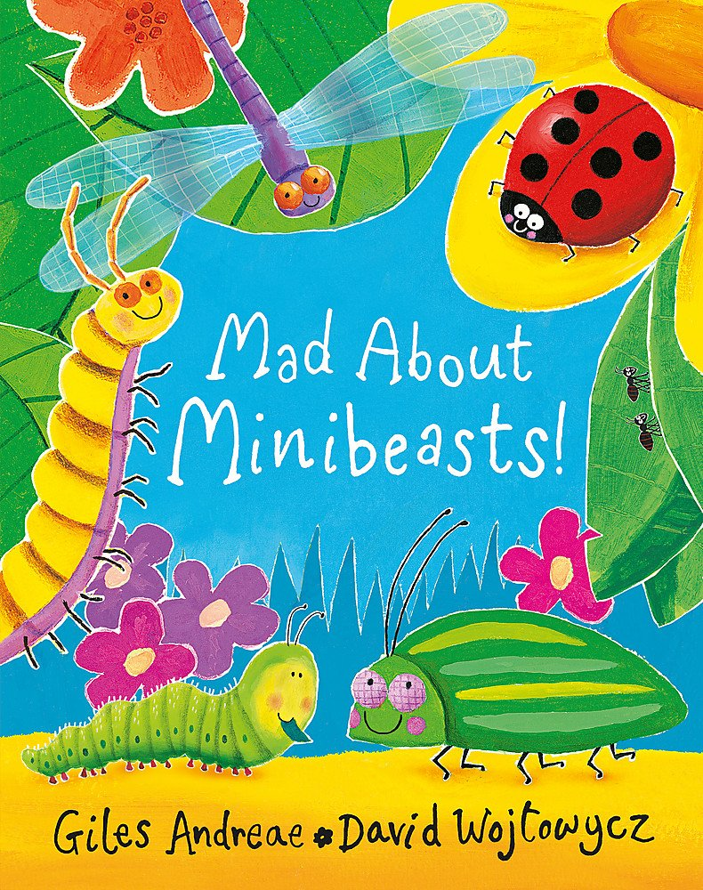
Mindfulness Moment
Which minibeast was your favourite?
Mad about Minibeasts
Reading stories is a great mindfulness activity!
Did you find any of the minibeasts in the story on your minibeast hunt?
How did this activity make you feel?
Don’t worry if you don’t have the book - Click here to listen to the story!

Slide 7

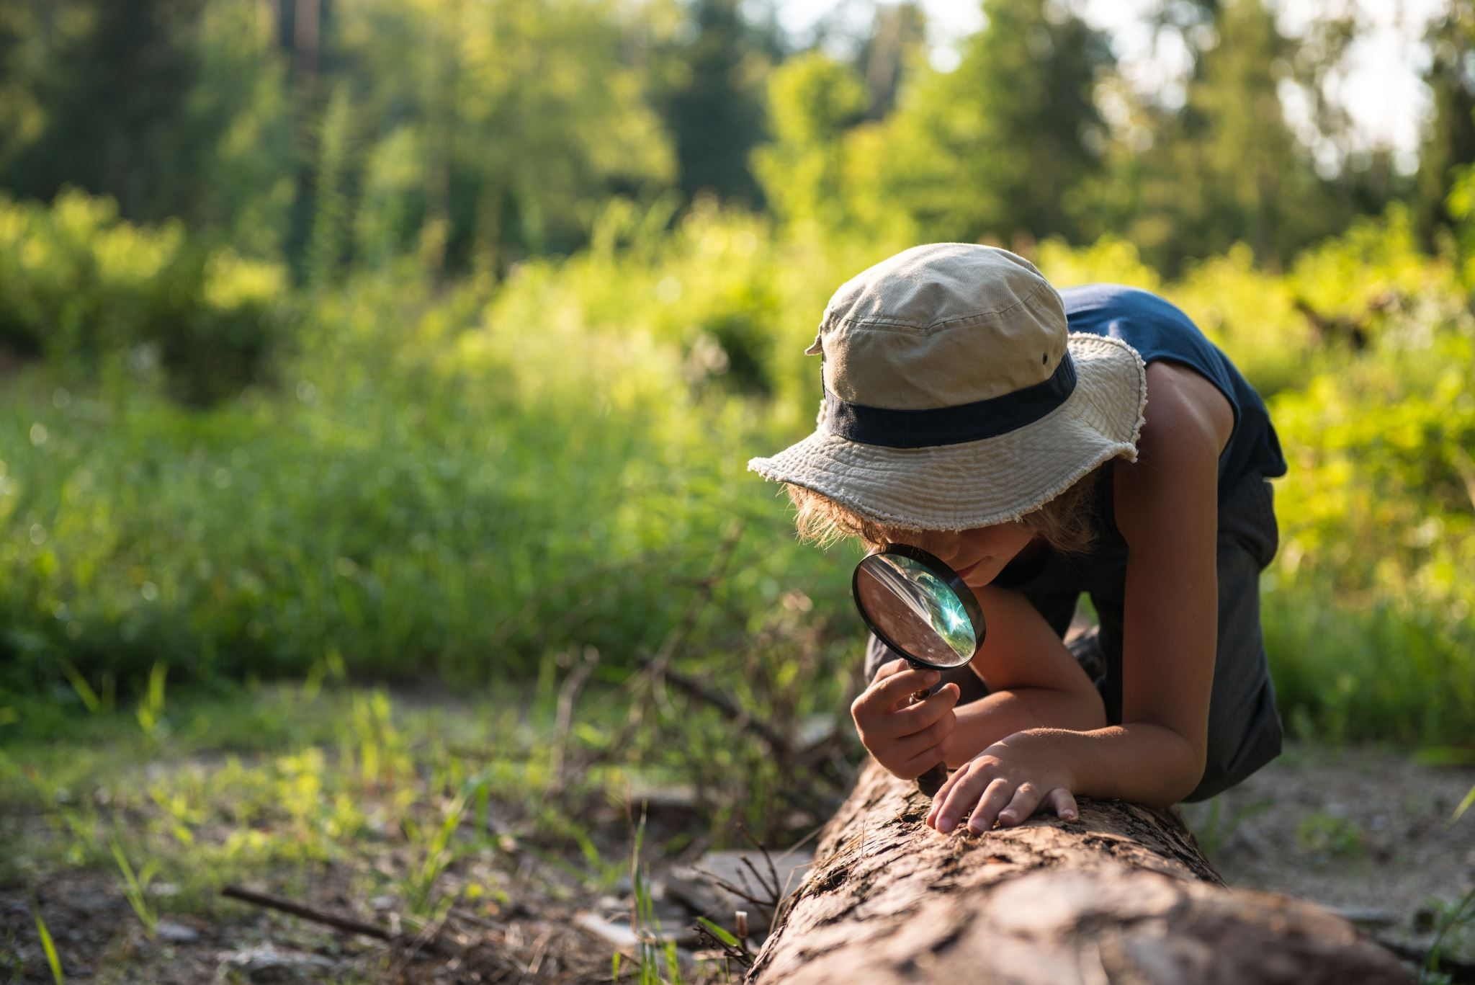
How did you get on?
What was your favourite activity?
Share your feedback by;
Emailing - ellen.blackwood@primary-forest-school.co.uk
Find us on Facebook or Instagram @PrimaryForestSchools

