Slide 1

Primary Forest School
Online Learning – KS2 Geography Activities

Slide 2

The important bit for parents and teachers… but you can have a sneak peek at the activities too!
Activity | Resources Required | Potential Risks | Impact
Water cycle – Make a natural water cycle | Various natural items | Contact with harmful object | Children understand the water cycle by creating their own using natural resources
Mapwork - use a map to find local footpaths and go on a new walk – can you identify hills, coasts and rivers on the map? | OS Map or online mapping | Getting lost! | Children are part of the decision making, using local routes to improve their understanding of maps
Carbon Footprint - Find out where your fruit comes from. Can you find a local source? | Water A bowl A marker pen or ruler | Ice can be harmful if touched | Children understand about the different states of matter of water
Pooh sticks – Does the weather affect the game? | Paper, foil, fruit and other materials you have around – anything goes! A bowl, bucket or bath of water | The floor might get wet! | Children understand the term ‘buoyancy’ and appreciate the different buoyancies of objects

Slide 3
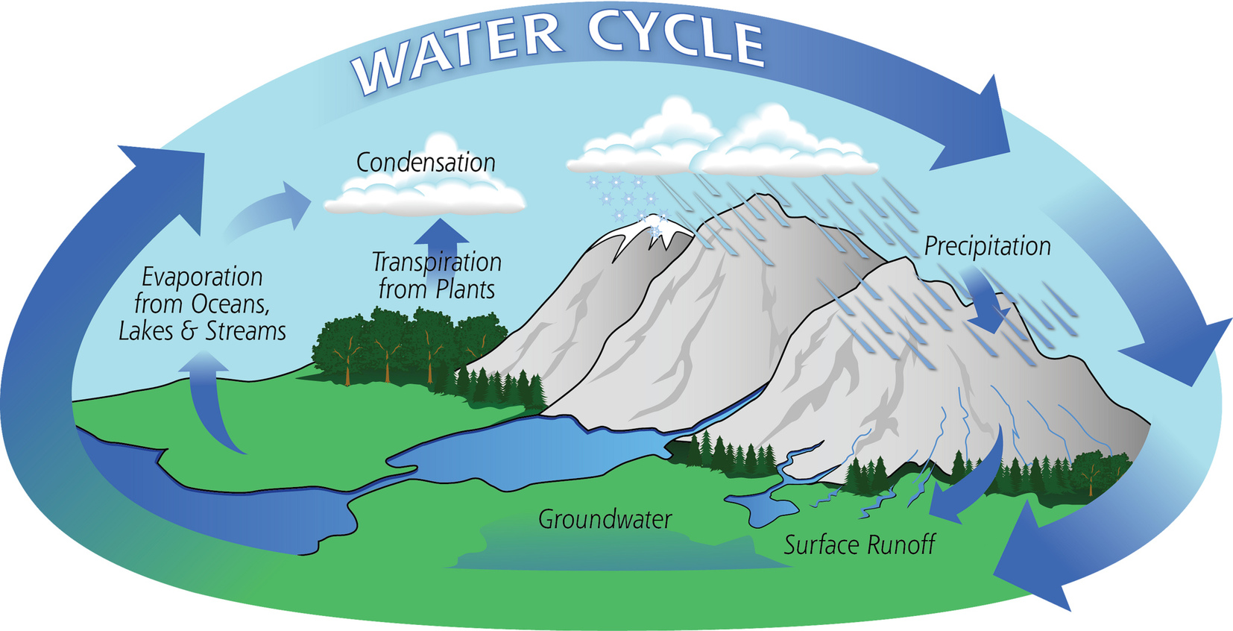
Water cycle – Make a natural water cycle
Water is cycled around the world constantly. Nature doesn’t make water, it just re-uses it!
Here is a version of the water cycle.
Can you make your own version using only natural materials?
Maybe you could use cotton wool for the clouds?
What about stones for the mountains?
Which has the largest mass? Which has the smallest?

Slide 4
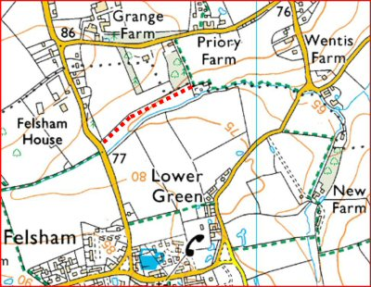
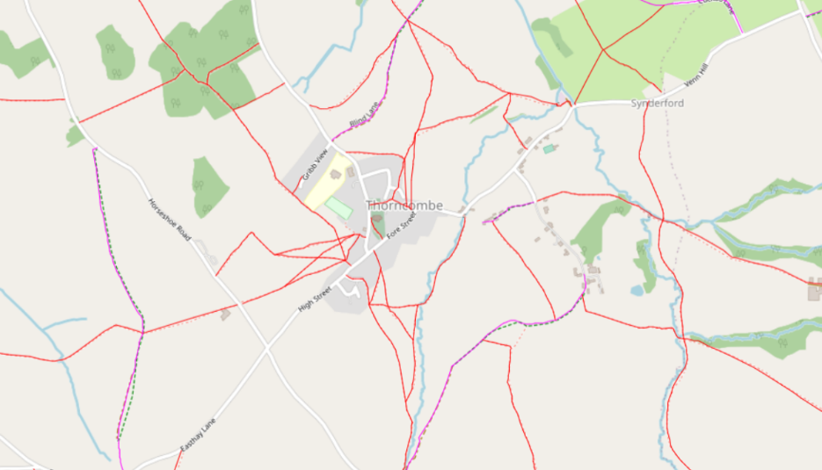
Mapwork - use a map to find local footpaths
There are thousands of miles of footpaths all over the UK and they have all been mapped.
Using a local map or online mapping (such as footpathmap.co.uk), can you find some local footpaths to you?
On an OS Map, they are green dashes.
Can you make a route, using footpaths, that you could follow for your next family walk?
Can you identify hills, rivers and coasts on your map too?

Slide 5
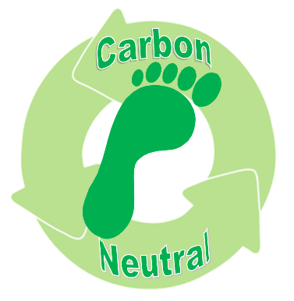
Carbon Footprint - Find out where your fruit comes from
Carbon Footprint describes how much carbon dioxide is produced in making and transporting goods. Factories produce carbon dioxide in some processes and all transport gives out carbon dioxide by burning fuel.
Some companies try to be ‘carbon neutral’ by reducing the carbon dioxide they produce and by transporting their products over less journeys or by combining with other companies to use less fuel
Others plant trees because trees absorb carbon dioxide and give out oxygen, which we need to breathe
Find out where your fruit comes from. It should say on the packet.
Can you use online mapping to find out how far that is?
Can you find a more local supplier for fruit? Maybe a farm shop or market stall?
A lorry produces 300-400g of carbon dioxide for every mile it drives!
While these can be more expensive, they are normally much better for the environment.

Slide 6
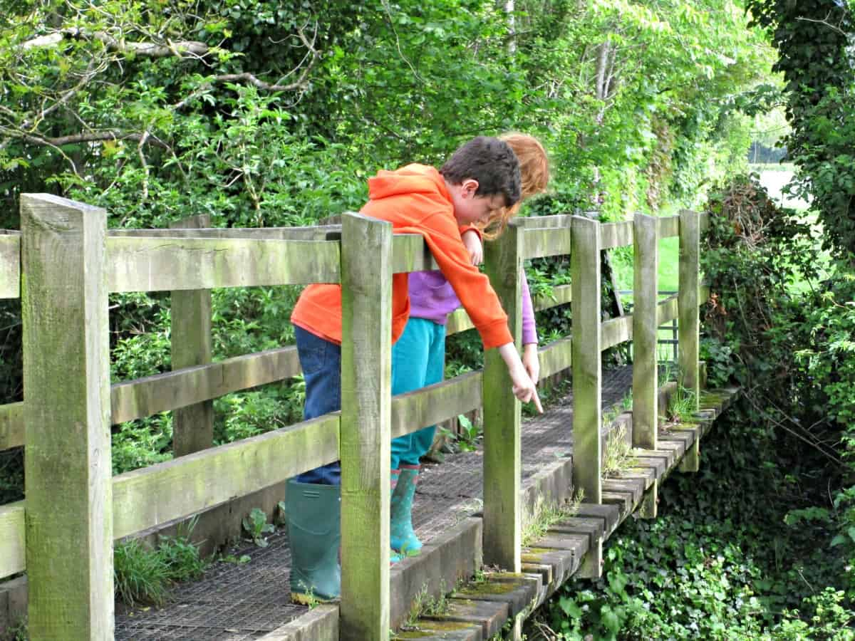
Pooh sticks – Does the weather affect the game?
Have you played Pooh Sticks before? The game comes from the books about Winnie the Pooh!
When you’re next on a walk, try and find a bridge over a stream.
Everyone finds a stick and drops them at the same time over one side of the bridge. Race to the other side and see which stick comes through first – they’re the winner!
Try playing after it’s been sunny and after it’s been raining. Does the weather make a difference? What if it’s raining when you play?

Slide 7

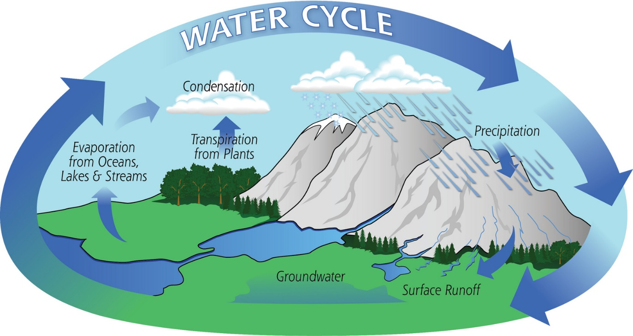
How did you get on?
What was your favourite activity from this pack?
Share your feedback by:
Emailing - ellen.blackwood@primary-forest-school.co.uk
Find us Facebook or Instagram @PrimaryForestSchools
Which has the largest mass? Which has the smallest?

