Slide 1
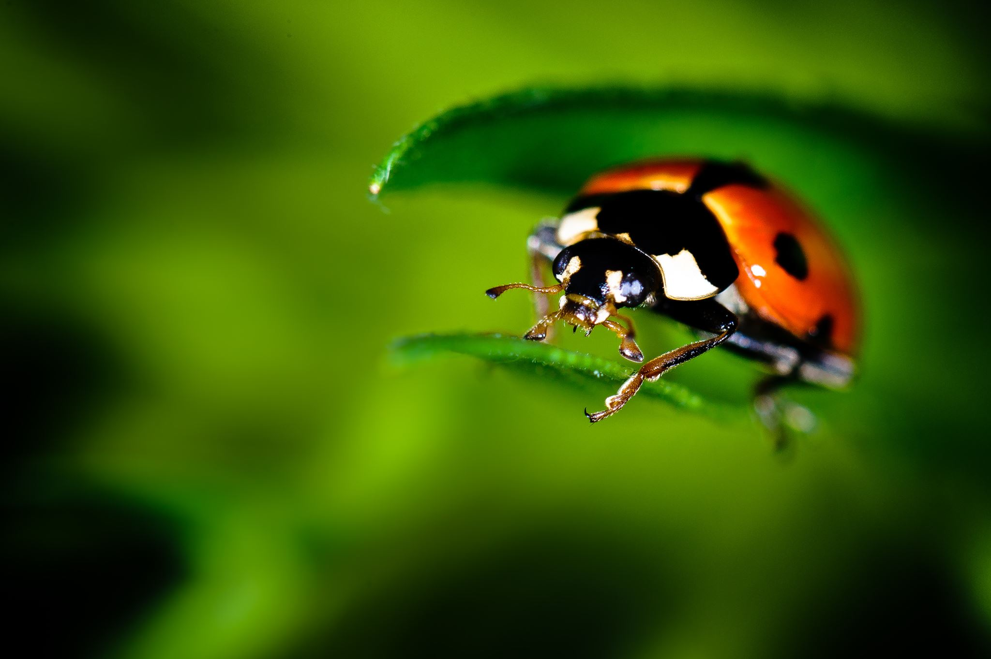

Primary Forest School
Online Learning – minibeasts KS2

Slide 2

The important bit for parents and teachers… but you can have a sneak peek at the activities too!
Activity | Resources Required | Potential Risks | Impact
Skill – Minibeasts Hunting | Bug pot (cleaned yoghurt pot), magnifying glass, outdoor area ideally with logs or stones on ground | Contact with harmful plants/ minibeasts, Lifting items, uneven grounds | Children to use investigative and exploratory skills to find and name and classify minibeasts
Main – Wormery | Large plastic bottle or glass jar, soil and sand, food peelings and dry leaves, worms | Use of sharp-edged items, Contact with harmful plants/ minibeasts, use of internet searching. | Children to understand the process of composting and be able to watch how worms live
Extended – Minibeast Masterpieces | Paper/ cardboard, paints, pens, other small objects for textures. | Use of paint, use of pens on skin/ clothes, getting messy! | Children to incorporate crafts and art into minibeast learning
Mindfulness – Mad about minibeasts | A quiet area to read – indoor or out | Sitting somewhere unsafe. | Children to read about their minibeasts and create their own verse.

Slide 3
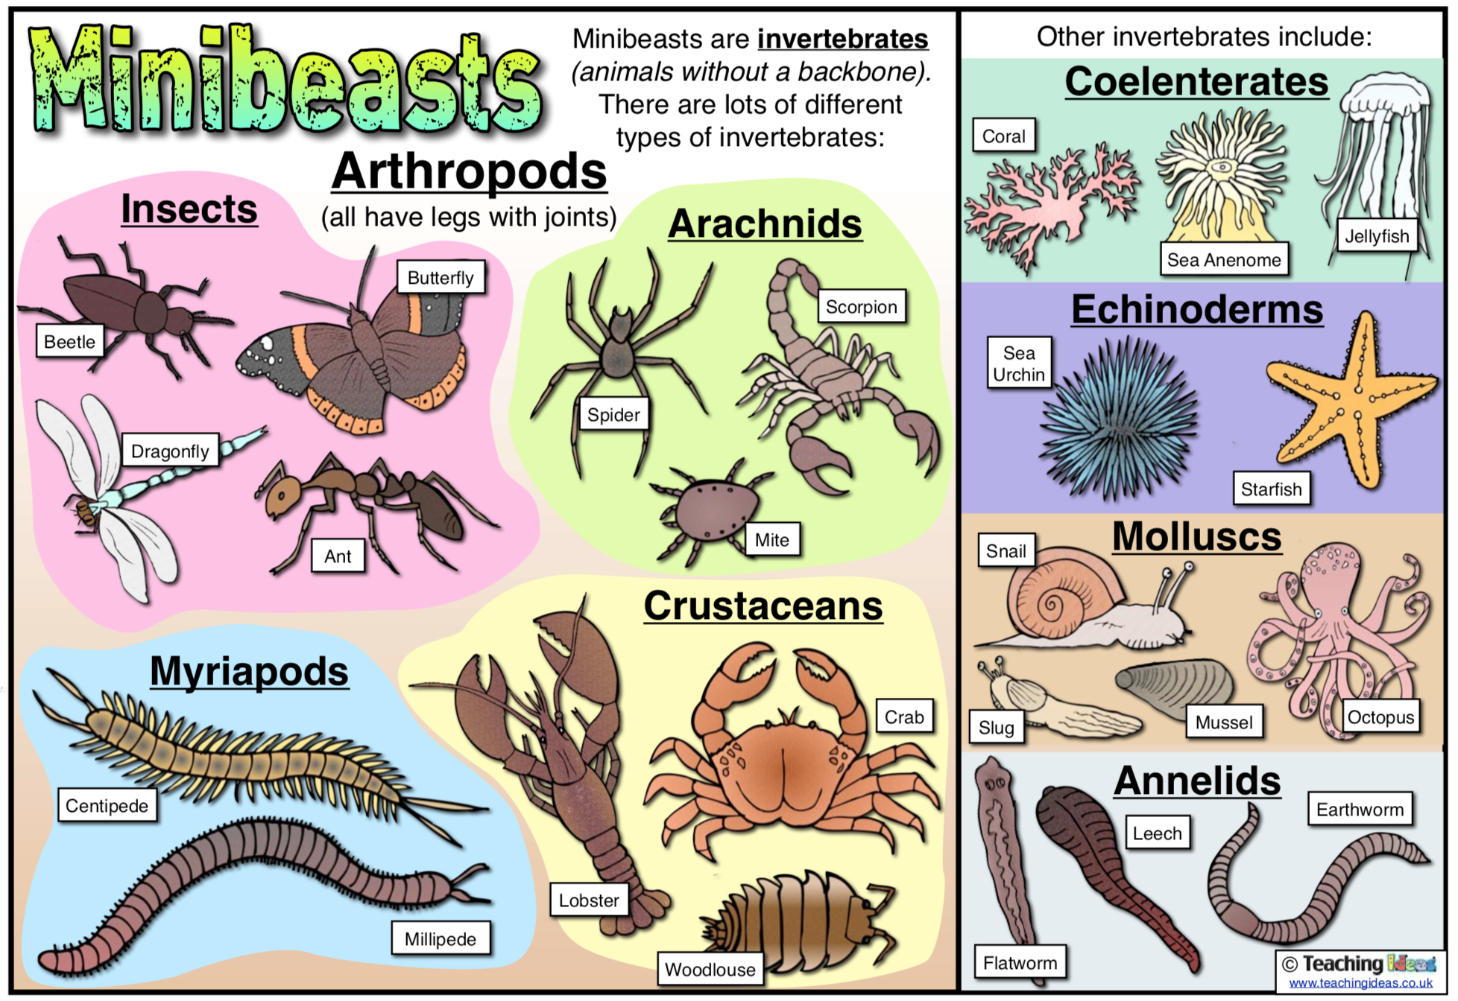
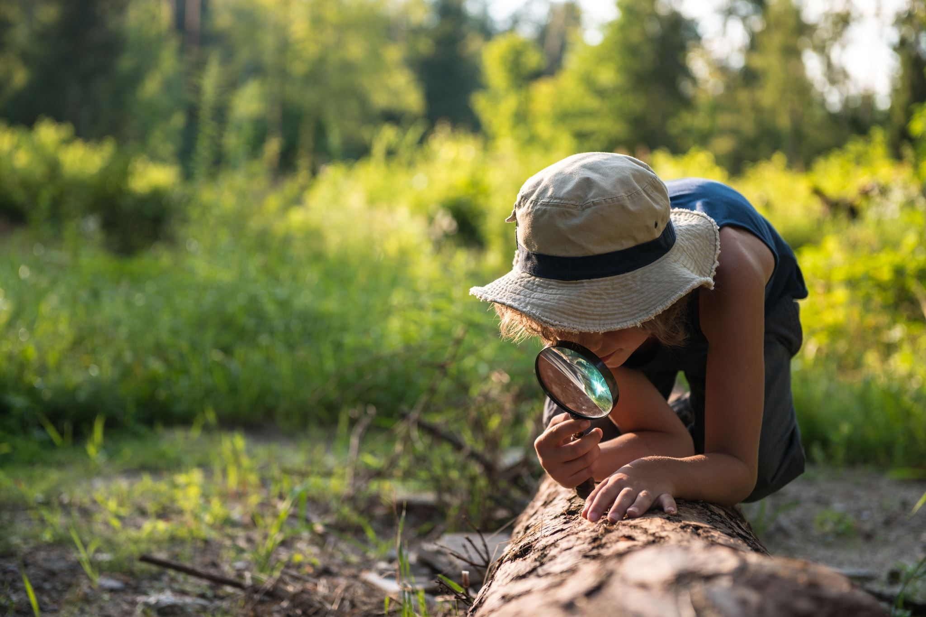
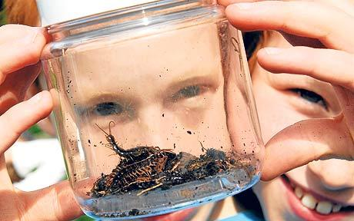
What will you find?
TOP TIP! Have a look under tree stumps and rocks… but remember to put them back too!
Minibeast Hunting
Exploring the outdoor space near you can you go on a minibeast hunt?
You will need to take a pot to collect your bugs in ... Even a clean yoghurt pot or glass jar will do!
For an extra challenge can you name all the minibeasts you find and identify their type – insect, arachnids, myriapods, crustaceans?

Slide 4
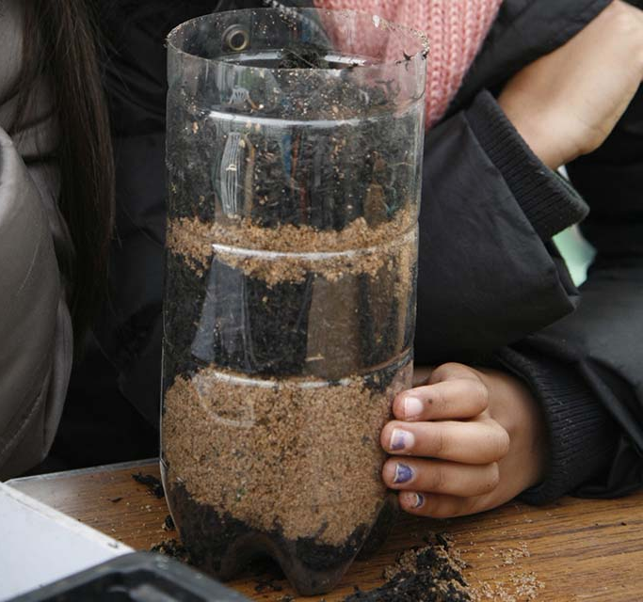
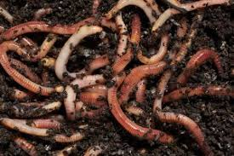
Wriggle and wiggle…
Compost is breaking down food peelings and dead leaves into soil.
Worms are amazing minibeasts and help us make compost. Can you find any wiggly worms in your garden or outdoors near you?
PARENTS TOP TIP! If using cut plastic bottles, tape any sharp edges.
Using something clear like a plastic bottle or jar, fill it with soil and sand. Then add your food peelings or dead leaves as the top layer.
Add your wriggly worms and visit them daily to see what they do. Remember to also keep the soil damp by sprinkling with water everyday and store in a dark cool place.
For an extra challenge can you find 5 fantastic facts about worms? Ask a family member, look in a book or search the internet.

Slide 5
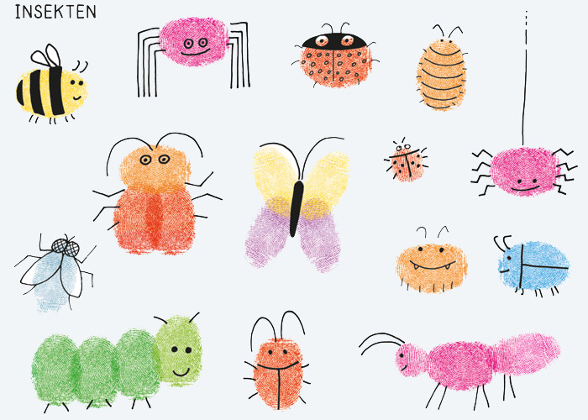
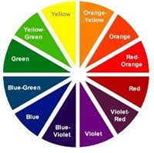
Minibeast Masterpieces!
Time to get creative and make your own minibeasts by only using your fingers! Use a sharpie or pen to draw on the final details once the paint has dried.
Try mixing your paint to get the colours you need.
For an extra challenge can you make habitats for your minibeasts using different objects to get the right texture?

Slide 6
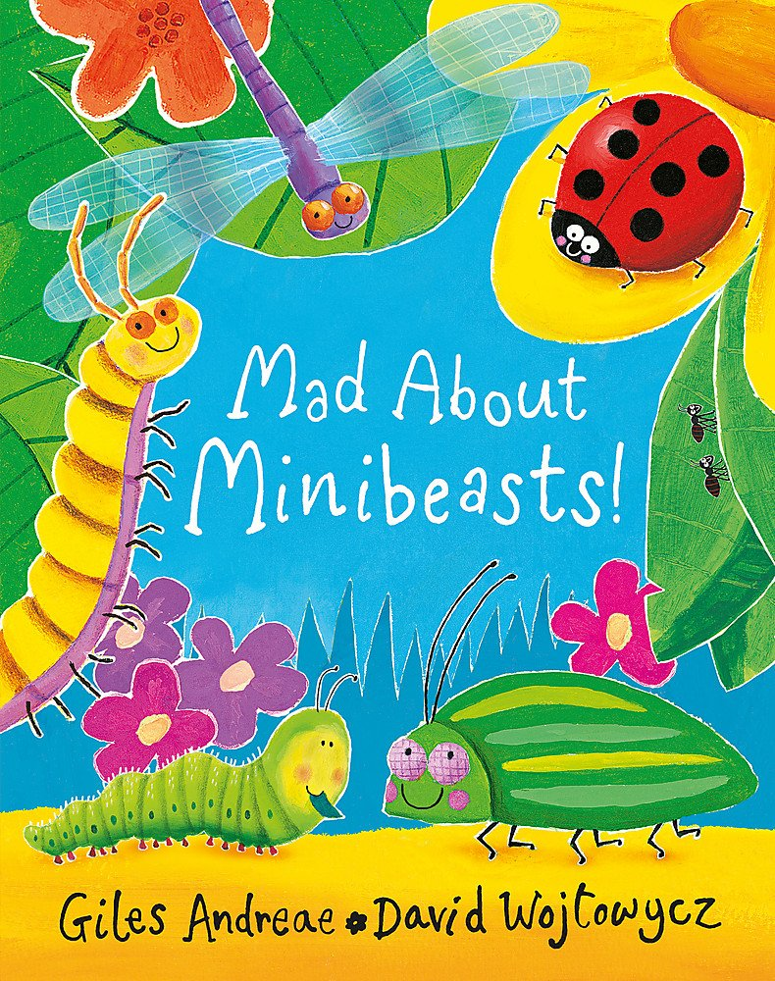
Mindfulness Moment
Which minibeast was your favourite?
Mad about Minibeasts
Reading stories is a great mindfulness activity!
How did this activity make you feel?
Don’t worry if you don’t have the book - Click here to listen to the story!
Can you write your own poetry verse on a mini beast you found?

Slide 7

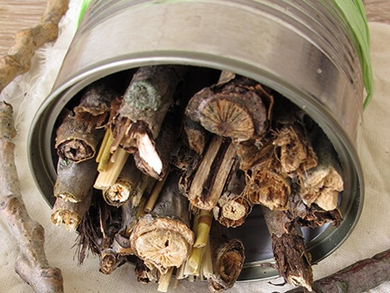
How did you get on?
What was your favourite activity?
Share your feedback by;
Emailing - ellen.blackwood@primary-forest-school.co.uk
Find us on Facebook or Instagram @PrimaryForestSchools

