Slide 2



Diving into Mastery Guidance
Each activity sheet is split into three sections, diving, deeper and deepest, which are represented by the following icons:
These carefully designed activities take your children through a learning journey, initially ensuring they are fluent with the key concept being taught; then applying this to a range of reasoning and problem-solving activities.
These sheets might not necessarily be used in a linear way. Some children might begin at the ‘Deeper’ section and in fact, others may ‘dive straight in’ to the ‘Deepest’ section if they have already mastered the skill and are applying this to show their depth of understanding.
Diving
Deeper
Deepest

Slide 3
Aim
Add and subtract fractions with the same denominator and denominators that are multiples of the same number.

Slide 4
Subtract – Breaking the Whole
Diving
starting number | find the equivalent fraction | subtract
1 3
5 6
3 6
1
2
−
=
Use this method to solve these calculations:
2 5
7 10
7 10
1 4
7 8
3 8
=
1
1
−
2
−
=

Slide 5
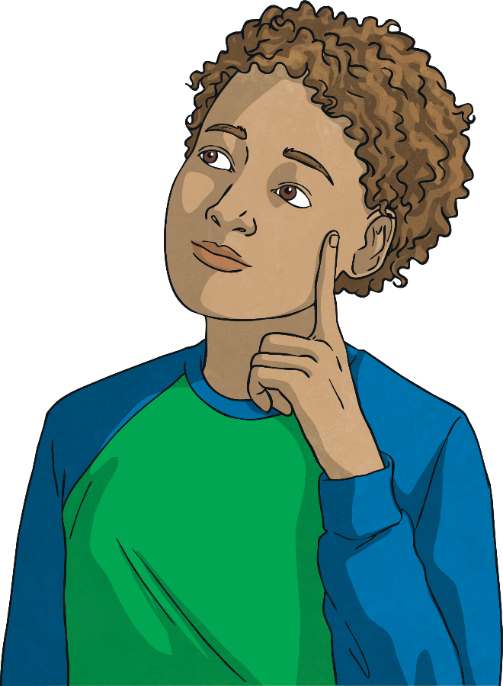
Subtract – Breaking the Whole
Diving
When we need to break up one of the wholes to subtract, we can use flexible partitioning.
1 4
−
7 8
=
1 4
7 8
2 8
7 8
3 8
4
3 + 1
−
=
3 + 1
−
=
3
Use flexible partitioning to solve these calculations:
1 5
3 10
1 5
3 10
2 10
3 10
9 10
2
−
=
1 + 1
−
=
1 + 1
−
= 1
1 4
5 8
1 4
5 8
2 8
5 8
5 8
4
−
=
3 + 1
−
=
3 + 1
−
= 3

Slide 6


Subtract – Breaking the Whole
Deeper
3 5
7 10
1 5
2
−
=
1
Explain the mistake that Isabel made.
Isabel forgot to make the fractions equivalent. This meant that she subtracted seven fifths instead of seven tenths. The correct answer is:
3 5
7 10
9 10
2
−
=
1

Slide 7
Subtract – Breaking the Whole
Deeper
I have five whole pizzas and one quarter of another pizza.
I eat three eighths of one of the pizzas. How much pizza is left?
Jacob has tried to use flexible partitioning to solve this word problem. What did he do wrong?
1 4
−
3 8
=
1 4
3 8
1 4
3 4
1 2
5
4 + 1
−
=
4 + 1
−
=
4
Jacob made a mistake when he was finding equivalent fractions. He should have converted 1 to 1 . He should not have tried to change into quarters.
1 4
2 8
3 8
1 4
3 8
1 4
3 8
2 8
3 8
7 8
The correct answer is:
5
−
=
4 + 1
−
=
4 + 1
−
=
4

Slide 8

Subtract – Breaking the Whole
Deepest
Fill in the missing digits to complete the calculations.
Give all fractions in their simplest form.
3
7
9
3
−
=
2
5
10
10
2
1
4
7
5
or
6
−
=
5
6
8
8
2
3
6

Slide 9
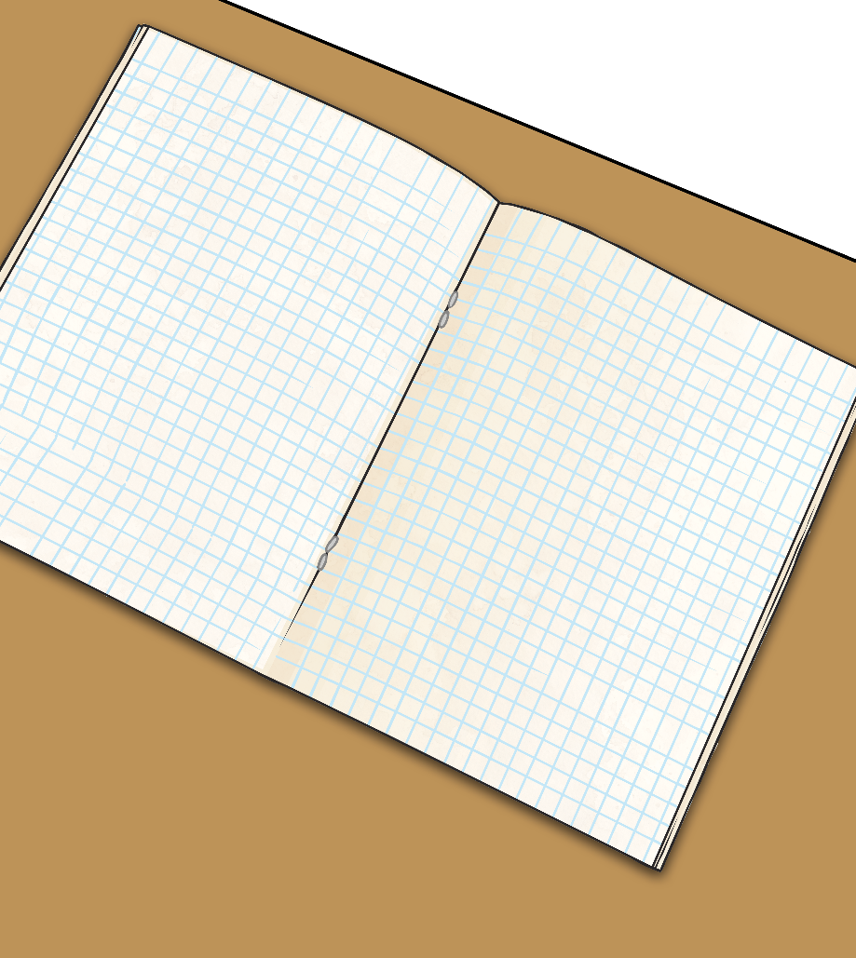
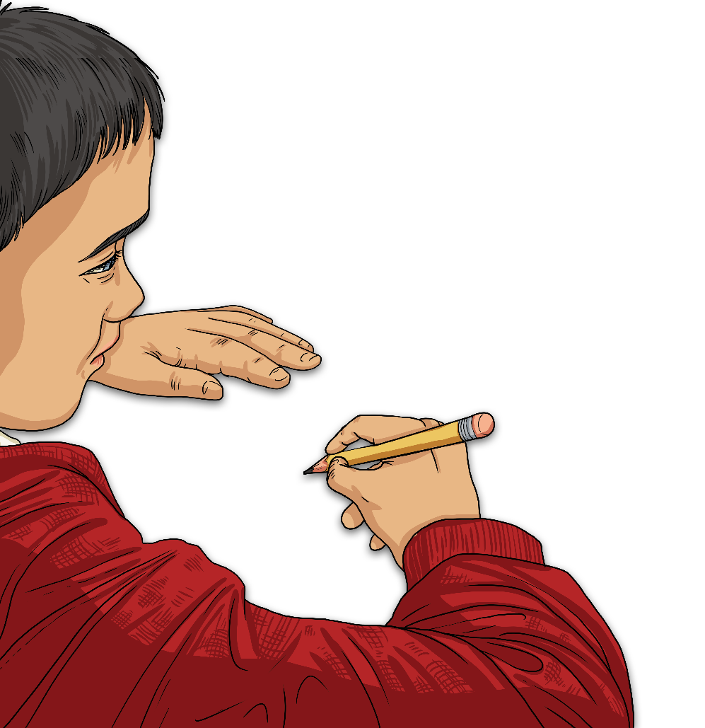
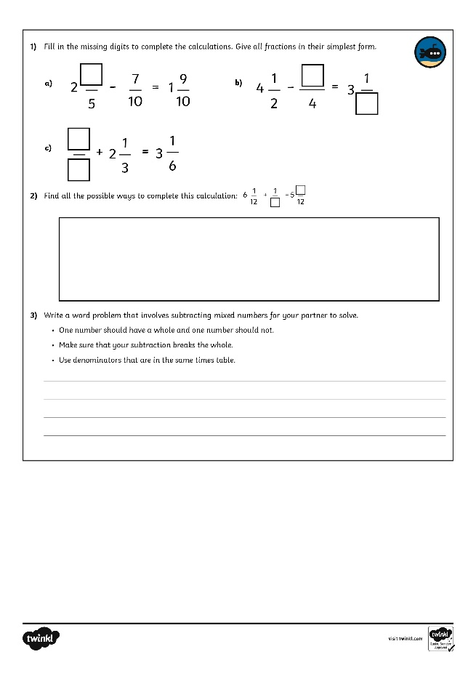
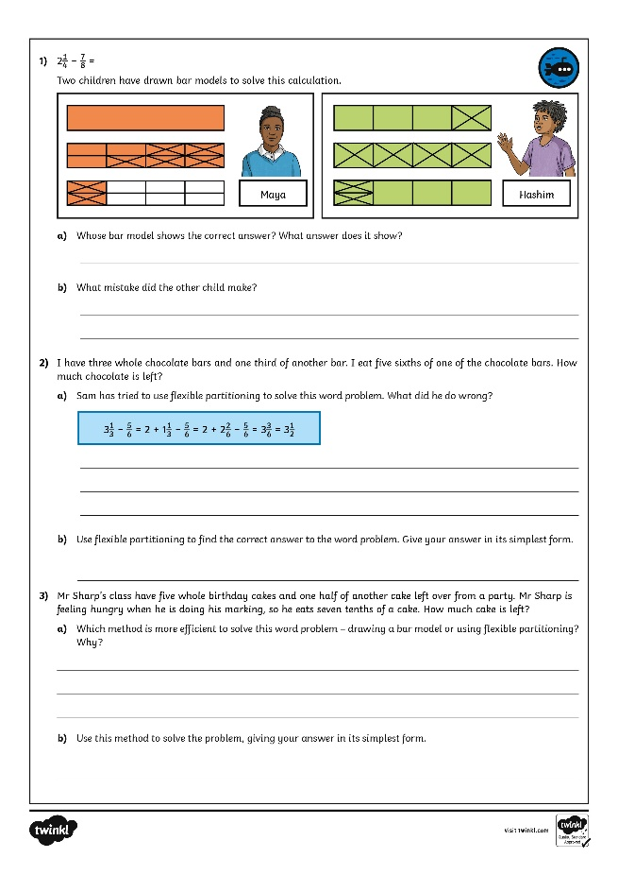
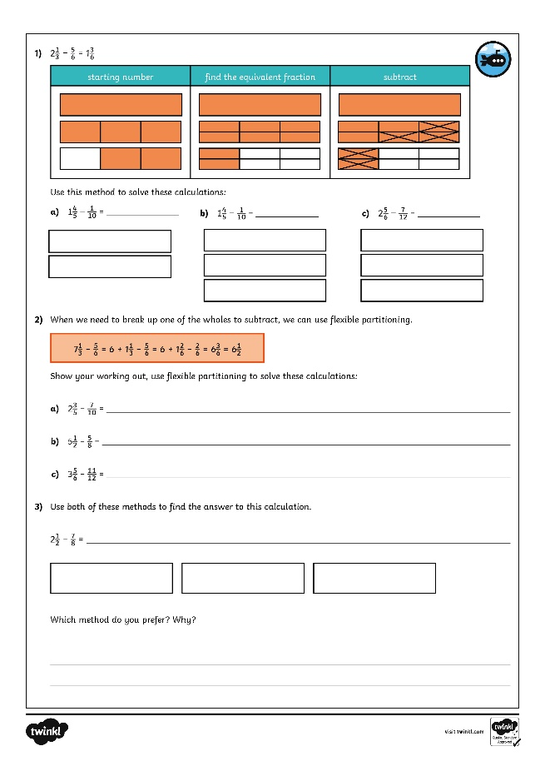
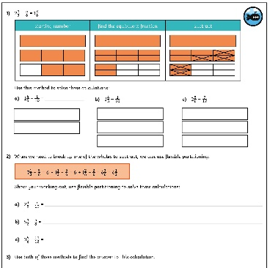
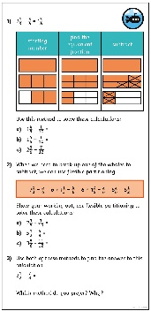
Subtract – Breaking the Whole
Dive in by completing your own activity!

