Slide 1
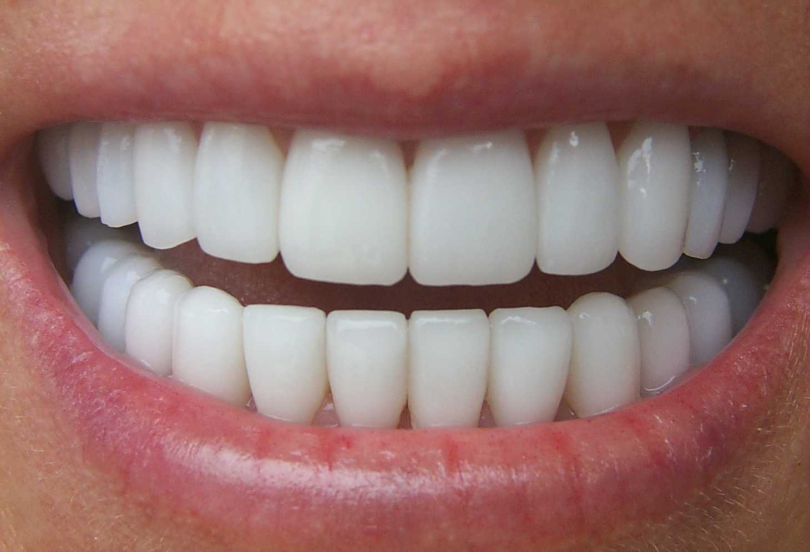
SCIENCE – Teeth and Eating!

Slide 2
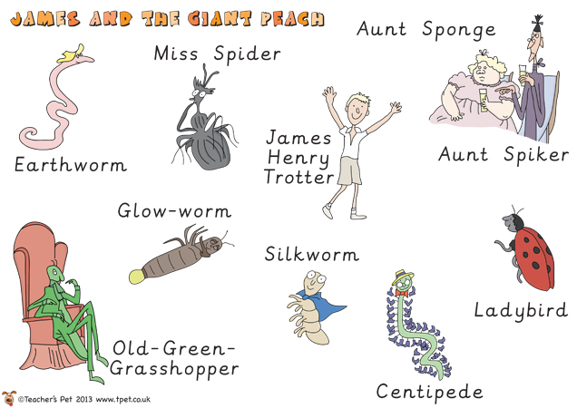
I’ve been talking to my new friends (and some old nags!) about their favourite drinks.
I’m a little concerned about whether their drinks are healthy for their teeth.
Can you help me find out please?

Slide 3
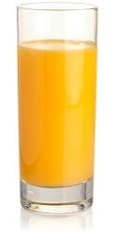
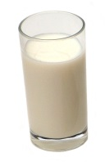
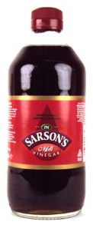
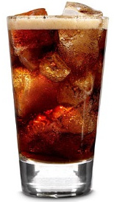
Oh, I love a bit of milk! It’s my favourite drink in the world!
Oh, the juicy refreshing taste of orange juice is my favourite!
Hmmm, I’m afraid I rather enjoy vinegar!! I sprinkle it on my crickets and have a glass every night before bed!
There’s nothing better than an ice cold cola! We have it every day!

Slide 4
Goodness me!! I enjoy drinking plain old water to be honest..
In order to help James, you are going to have to be scientists!!

Slide 5
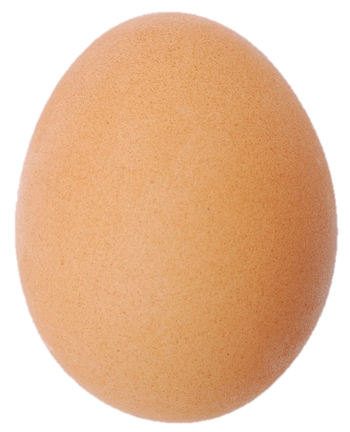
Could we use your real teeth to test these liquids?
NO!!!
We can use different things as a model of a tooth!
Think about how an egg shell might be similar to a tooth.

Slide 6
James wants us to find out which drink is the best (or worst) for our teeth.
Our question…
Which drink is the best for our teeth?
How are we going to do this? We have eggs and different liquids.
How will we make it fair?
What will we change? (posh WOW word – things that we change are called the variables!)
Which liquid do you think will be best/worst for the teeth? Why?
When should we take observations?

Slide 7
Thank you for being super scientists and helping me. I couldn’t have done it without you. I look forward to seeing your results!

